Slide 1
Creating Connections forecasting, Food ordering & waste reduction
Provided by the LAUSD Food Services Division
Notes:
TELL: THIS IS JUST A PLACE HOLDER FOR SCREEN BEFORE THE PRESENTATION IS READY TO BEGIN

Slide 2
Creating Connections forecasting, Food ordering & waste reduction
Provided by the LAUSD Food Services Division
Notes:
TELL: Welcome to the Food Ordering, forecasting and waste reduction training for the 2017 LAUSD food services managers orientation.

Slide 3
Overview
A successful food service program requires attention when forecasting production so that it sustains low waste figures. This means management must continue to use everyday data to create favorable results.
This training will focus on:
Accurate forecasting that improves control of inventory
Understanding the relationship between food ordering and food cost
Ways to reduce waste in the operation
Notes:
TELL: A successful food service program requires great attention when forecasting production so that it sustains low waste figures. This means management must continue to use everyday data to create favorable results. Today’s training will focus on accurate forecasting that improves control of your inventory while understanding the relationship between food ordering and food cost in your cafeteria. We’ll finish the training discussing waste reduction in your operation and how creative ways of increasing participation can help reduce waste.
NEXT SLIDE:

Slide 4
Objective
When historical data is applied during the forecast process, ordering food based on usage results in reduced waste figures.
Forecasting
Food Ordering
Waste Reduction
Happy Food Services Division
Following forecasting methods will directly affect cost and profit.
Notes:
TELL: There’s a connection between the big 3 we’ll discuss today. When we utilize historical data and apply it to our forecasts, we can order accurate amounts of items based on usage which will result in reduced waste figures.
NEXT SLIDE:

Slide 5
Everyday Has A Cost
Costs are associated with the budget everyday in the cafeteria. For the division to continue to be fiscally independent, it is important to pay attention to details such as:
Smart usage of paper goods
Preparing menu items following recipes
Ordering utilizing real data and figures
Monitoring inventory actively
Notes:
TELL: Everyday has costs that are associated with your budget in the cafeteria. For our food services division to continue to be fiscally independent, it is important to pay attention to details. These details can be as simple as the smart usage of paper goods and following recipes or as complex as using the data and figures created everyday to order accurate amounts. Finally you want to be an active manager that is actively monitoring inventory.

Slide 6
The People, Process, and Product
Understanding the role people play will improve the process which leads to a consistently favorable product. This can improve production and service to increase participation.
Process
Product
People
Notes:
TELL: Helping you understand the value of people will improve the process which leads to a consistently favorable product. The people have perhaps the largest role in improving the 3 P’s because they are the single driving force of how well the process is executed. A well-thought out process is running beautifully when people follow the process correctly and communicate any issues that may arise. It takes us to the final P which is a great product that is favorable, the possibilities that come after this can be an increase in participation which allows for growth.

Slide 7
The People
The people have the primary and perhaps largest role in improving the 3 P’s.
Notes:
TELL: The people have the primary and perhaps largest role in improving the 3p’s.

Slide 8
The Process
When people follow the process correctly, the end result is a great product.
Notes:
TELL: When people follow the process correctly, the end result is a great product.

Slide 9
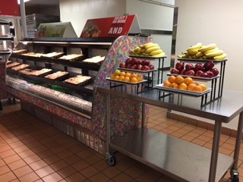
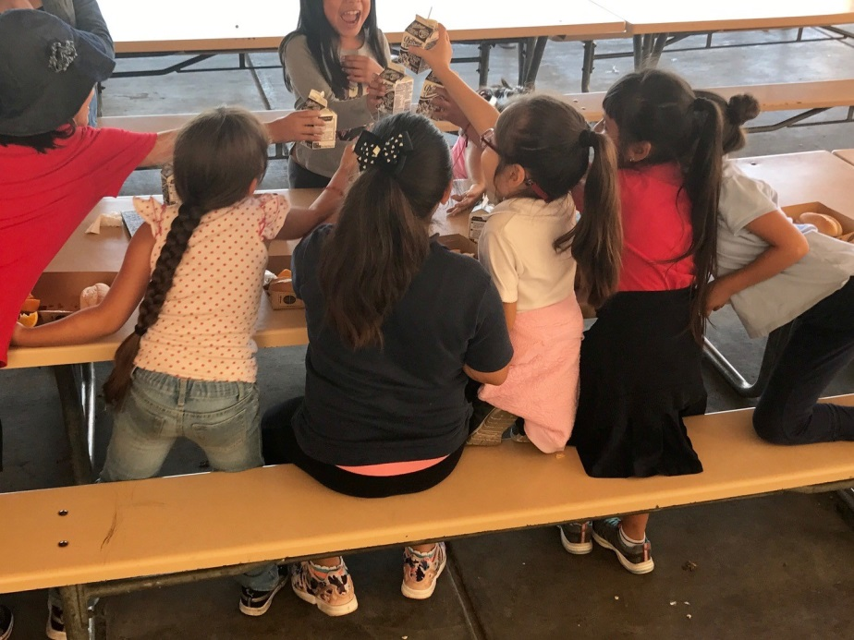
The Product
A great product results in favorable results from customers which can lead to increases in participation.
Notes:
TELL: Finally, a great product results in favorable results from customers which can lead to increases in participation.

Slide 10
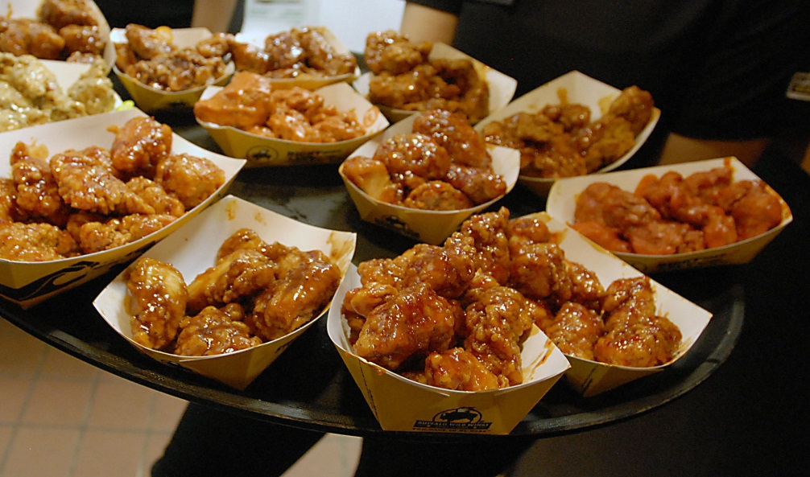
Don’t Wing It
Buffalo Wild Wings employees have been eyeballing recipes. The manager notices that the sales for the month of January decreased, however the cost of goods for the month saw a 12% increase.
Notes:
TELL: Let’s take a look at the 3 P’s in action. Buffalo Wild Wings employees have been eyeballing recipes. The manager notices that the sales for the month of January decreased, however the cost of goods for the month saw a 12%increase.
NEXT SLIDE:

Slide 11
Don’t Wing It
The increased food cost is a result of the?
People
People
The staff did not follow recipes which led to the increased cost for Buffalo Wild Wings during a slower month.
Process
Product
Notes:
Ask: The increased food cost is a result of the what? Is it the people, process or product?
Click: It’s the people. The people not following recipes led to the increased cost for Buffalo Wild Wings during a month where costs should’ve decreased.
NEXT SLIDE:

Slide 12
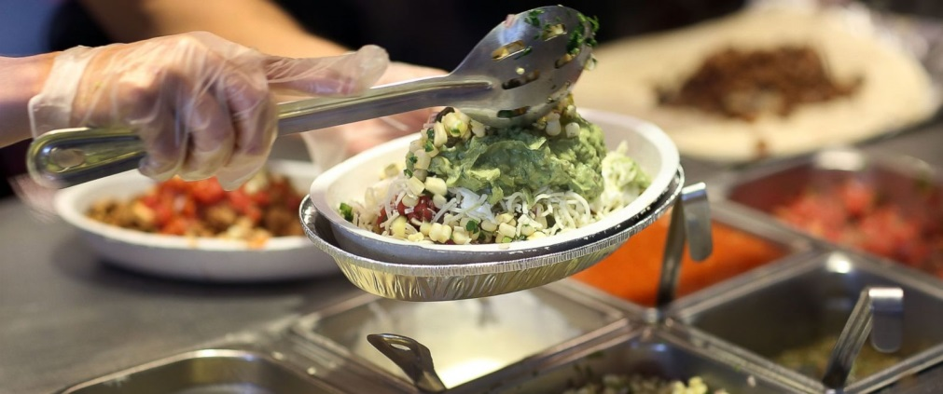
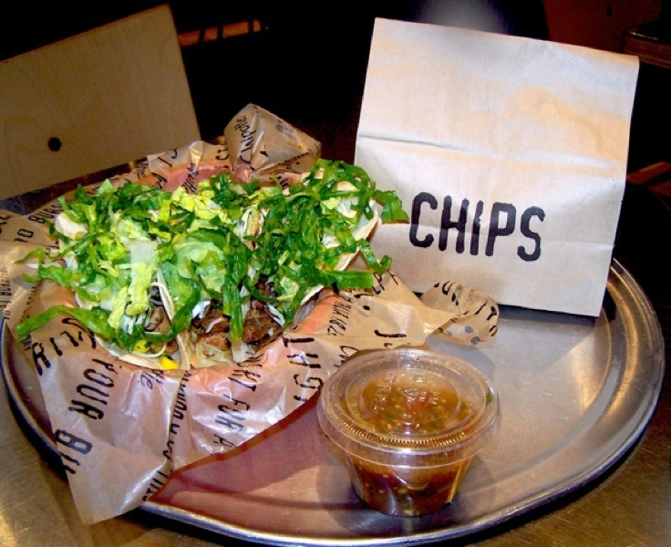
Lettuce Make a Change
Chipotle was recently in the news for having contaminated lettuce served to customers as a result of not being cleaned by the vendor properly. This has led to many customers getting sick.
Notes:
TELL: Our last example shows the ever so popular Chipotle that was recently in the news for having contaminated lettuce served to customers as a result of not being cleaned by the vendor properly. This has led to many customers getting sick.
NEXT SLIDE:

Slide 13
Lettuce Make a Change
Which P has been affected?
People
Process
The process was highly affected for chipotle by it’s vendor which led to an unfavorable product, the result was a decrease in sales and a financial loss.
Process
Product
Notes:
Ask: Which P has been affected? Is it the people, process or product?
Click: It’s the process. The process was highly affected for chipotle by it’s vendor which led to an unfavorable product, the result was a decrease in sales and a financial loss.
NEXT SLIDE:

Slide 14
A Pizza Improvement
Dominos Pizza has seen lower sales than Papa Johns. Through customer survey they realized customers complained the most about there crust being too dry and unappealing in taste.
Notes:
TELL: In this example, Dominos Pizza has seen lower sales than Papa Johns. Through customer survey they realized customers complained the most about there crust being too dry and unappealing in taste.
NEXT SLIDE:

Slide 15
A Pizza Improvement
Which P can be improved?
Product
People
The product needed to be modified and reformulated to meet the customers preferences based on feedback received.
Process
Product
Notes:
Ask: Which P can be improved? Is it the people, process or product?
Click: It’s the product. The product itself needed to go through a change in order to suit customer’s and not fail.
NEXT SLIDE:

Slide 16
How Do The 3 P’s Relate to Café LA
Consistency is
To continue making improvements, all Food Services Staff must follow recipes and trust the process. This leads to making a great product that customers can enjoy and keep them returning.
Notes:
TELL: You may be asking yourself how does this relate to forecasting, food ordering, and waste reduction. Well it’s all about consistency. To reduce waste, it does start with the attention that you and your staff gives to the product for your customers. Make the most out of every opportunity to get customers to come back. Doing so will lead to increased participation and a customer base that is actually consuming what we give them.
NEXT SLIDE:

Slide 17
Daily Forecasting
Continually making adjustments to the daily forecast of meals for all meal programs will result in:
Accurate information being utilized
Ordering correct amounts
Eliminating over production of food items
Lowering food cost
Reducing unnecessary labor costs
Notes:
TELL: Let’s dive into daily forecasting. Proper forecasting of meals on a daily basis can reduce food cost and waste. Continually make adjustments to the daily forecast of meals will result in eliminating over and excess production of food items, lowering food costs, reducing unnecessary labor costs, forecasting more accurately and utilizing information more frequently which leads to ordering correct amounts.

Slide 18
Forecasting Tools
When forecasting, utilize the tools and information available to avoid inaccuracies in ordering and food production.
BIC Tracking Tool
Lunch Production Record
Supper Meal Count Form
Notes:
TELL: Forecasting should always use accurate and relevant data. As managers it is important to utilize the tools and information available to avoid inaccuracies in ordering and food production. The 3 forms we’ll discuss will show you how to provide accurate information to your forecasts.

Slide 19
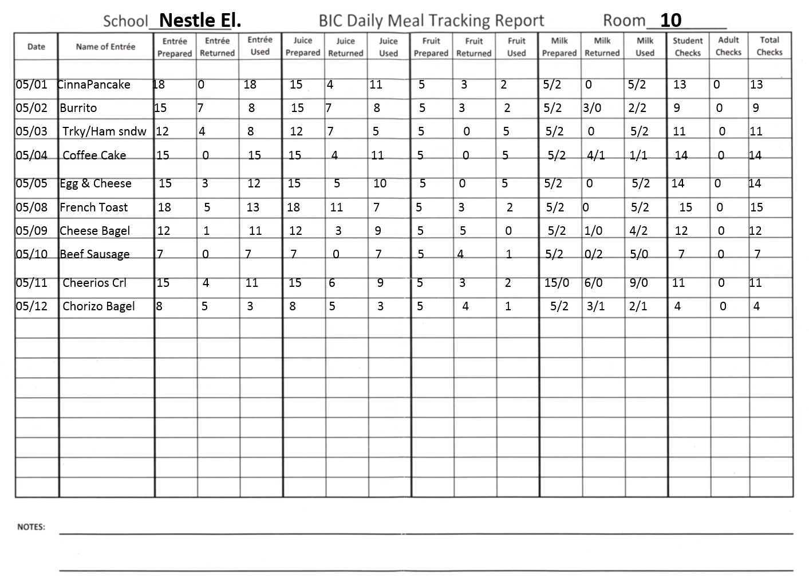
BIC Tracking Tool
Tracking participation of individual breakfast items provides the cafeteria with useful data to learn patterns in student preferences.
The BIC Daily Meal Tracking report is used to:
Forecast accurately for each food item
Guide food services staff when packing the BIC bags
Notes:
TELL: With the BIC tracking tool, tracking consumption of breakfast items provides the food service managers with useful data to learn patterns in student preferences and be able to order accordingly. This report is used to forecast accurately for each food item. This will also guide food services staff when packing the BIC bags.

Slide 20
Lunch Production Records
When forecasting menu quantities, look beyond the amount actually served.
Focus on ensuring the first and last customer have a choice of the same items throughout the meal service.
Prepare enough meals so the first student that passes through your line has the same options as the last students.
Notes:
TELL: With lunch production records it is important to know that these records go beyond the numbers. They guide managers on what amounts to prepare and how that will satisfy all of our customers preferences throughout meal service. What we mean by this is to understand how to prepare and serve amounts that allow options for all customers. For example, on a day where we are serving hamburgers and tuna sandwiches, prepare enough sandwiches and serve them in a way that the first student that walks through the line will have the same options as the last student that comes through the line.

Slide 21
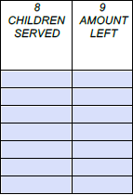
Supper Participation
Supper participation is important to track so that we maximize our abilities to reach customers.
Remember to forecast using the data from your meal count forms.
Pay attention to menus for the day and how participation is affected.
28
72 28
28
70 28
2 0
A popular day like hamburgers that show a 28% waste figure, if no outside factors affected participation decrease the amount prepared to 80.
Notes:
TELL: Food services has benefited from the success of our supper program thanks to managers throughout the district implementing hot supper. When it come to supper forecasts, we want to understand meal counts and production based on actual figures from our supper meal count form. This allows us to maximize our abilities to reach every potential customer. Remember to base your production counts on the data from your meal count forms and pay attention to menus for the day and how participation is affected by popularity of that item.

Slide 22
The Ordering Calendar
Following the ordering calendar will ensure successful ordering that avoids discrepancies. Follow the steps below in order:
Process EZ steps
Creates production records and shopping lists
Edit and save shopping lists
Allows adjustments to be made based on what current inventory levels are
Complete shopping lists
Completion of orders once double checked for any errors
Notes:
TELL: Following the ordering calendar will ensure successful ordering that avoids discrepancies. Follow the steps below in order: process ez steps, creates production records and shopping lists, edit and save shopping lists, allows adjustments to be made based on what current inventory levels are, complete shopping lists, and completion of orders once double checked for any errors.

Slide 23
A Quick Forecasting Review
Forecasting of meals within CMS gives the FSM an opportunity to plan menu quantities and create shopping list based on the delivery schedule of the school site.
2 Weeks prior to delivery
Follow CMS calendar for changes
Generates appropriate amounts for recipes
Notes:
TELL: Forecasting of meals within CMS gives the FSM an opportunity to plan menu quantities and create shopping list based on the delivery schedule of the school site. 2 Weeks prior to delivery. Follow CMS calendar for changes. Generates appropriate amounts for recipes.
NEXT SLIDE:

Slide 24
Forecasting For Off-sites
Off-sites
Complete menu forecast for each off-site
Do not process the menu forecast
Manually add quantities to main site shopping list
Do not forecast the same amount for all menu items (e.g., 50 calzone, 50 tater tots, 50 broccoli, 50 apples, 50 milk)
Notes:
TELL: When forecasting for off-sites, complete menu forecast for each off-site, do not process the menu forecast, manually add quantities to main site shopping list, do not forecast the same amount for all menu items (e.g., 50 calzone, 50 tater tots, 50 broccoli, 50 apples, 50 milk).
NEXT SLIDE:

Slide 25
EZ-Step Ordering
Proper menu planning ensures that there are no food shortages in the cafeteria. EZ-steps are CMS OneSource menu planning tool used to assist managers with the food order process by:
Keeping track of menu plans on different days
Creating shopping list for ordering
Notes:
TELL: Proper menu planning ensures that there are no food shortages in the cafeteria. EZ-steps are CMS OneSource menu planning tool used to assist managers with the food order process by: keeping track of menu plans on different days and creating shopping list for ordering.

Slide 26
Utilize The History Tab
When processing EZ steps, use the tool to display multiple production histories.
The History tab will show the amounts served prior to the dates being processed.
Adjust the “MP Qty” to a number close to your history to reduce the amount of leftovers.
Notes:
TELL: When processing EZ steps, use the tool to display multiple production histories. The History tab will show the amounts served prior to the dates being processed. Adjust the “MP Qty” to a number close to your history to reduce the amount of leftovers.

Slide 27
Why We Follow Menu Plans
Following approved menu plans ensures that USDA nutritional requirements are being met and keeps the inventory rotation within the cafeteria at a constant level.
Breakfast and Lunch follows a 4 week rotation
Snack on a 1 week rotation
Supper rotation will repeat (TBD)
By repeating items on the menu, FSM’s can forecast and plan for the popularity of items by adjusting EZ-step meal counts.
Notes:
TELL: Following approved menu plans ensures that USDA nutritional requirements are being met and keeps the inventory rotation within the cafeteria at a constant level.
Breakfast and Lunch follows a 4 week rotation
Snack on a 1 week rotation
Supper rotation will repeat (TBD)
By repeating items on the menu, FSM’s can forecast and plan for the popularity of items by adjusting EZ-step meal counts.

Slide 28
The EZ Steps Day
Everyone’s Happy
Following the ordering calendar is a simple tool that we have to outline the process for ordering once we have the data needed.
When using the ordering calendar always follow the steps in the indicated order.
3. EZ Steps Menu Plan Quantities
August 21-25 Due by 3pm
Edit and save Shopping list
August 14-18 Due by 3pm
Edit and save Shopping list for Goldstar-S
August 21-25 (All Sites) Due by 3pm
Edit & complete Driftwood order for next Tuesday By 2pm
1st
EZ Steps Menu Plan Quantities
August 21-25 Due by 3pm
2nd
Next
Edit and save Shopping list
August 14-18 Due by 3pm
3rd
Next
Edit and save Shopping list for Goldstar-S
August 21-25 (All Sites) Due by 3pm
4th
Finally
Edit & complete Driftwood order for next Tuesday By 2pm
Notes:
TELL: Following the ordering calendar is a simple tool that we have to outline the process for ordering once we have the data needed.
When using the ordering calendar always follow the steps in the indicated order.

Slide 29
Shopping List
Vendor shopping list are generated from the processed EZ-step forecasts and include all ingredients necessary to produce a menu item.
Review the school assignment calendar to check for holiday’s or unassigned days approaching
Add any non-menu items to shopping list
Paper goods
Equipment
Chemical orders
Notes:
TELL: Vendor shopping list are generated from the processed EZ-step forecasts and include all ingredients necessary to produce a menu item. Review the school assignment calendar to check for holiday’s or unassigned days approaching. Make changes to your shopping list to ensure your will receive food items needed by adding any non-menu items to shopping list such as paper goods, equipment, chemical orders.

Slide 30
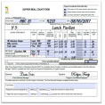
Edit & Save The Shopping List
Prior to saving the shopping list ensure that common, low usage menu items such as spices, beans, tomato paste, and croutons are removed if not needed.
Review shopping list
Remove unneeded items
Add any needed items
Save shopping list
Keep costs down using AFSS “Target” shopping lists value
All shopping lists must be saved according to the CMS ordering calendar by 3:00 pm.
Notes:
TELL: Prior to saving the shopping list ensure that common, low usage menu items such as spices, beans, tomato paste, and croutons are removed if not needed. Be sure to review the shopping list, remove unneeded items on your list and add any needed items and save the shopping list. By being proactive you’ll keep costs down using the target shopping value which is information provided by your area food service supervisor. Remember that all shopping lists must be saved according to the CMS ordering calendar by 3:00 pm.

Slide 31
Editing The Shopping List
Common issues that lead to increased inventory cost can be avoided by:
Reviewing the quantities populated based on forecasted amounts
Making adjustments considering the current inventory on hand
Using the menu and projected quantities as a reference
Comparing the shopping lists totals to the site targeted shopping list value
Notes:
TELL: When it comes to editing the shopping list, avoid common issues that lead to increased inventory cost by reviewing the quantities populated based on forecasted amounts, making adjustments considering the current inventory on hand, using the menu and projected quantities as a reference and comparing the shopping lists totals to the site targeted shopping list value.

Slide 32
Factors Affecting Forecasts
Identifying factors that could potentially affect participation counts before ordering and producing food items will improve the forecast.
Communicating with students and site administrators will help to identify factors relating to:
Student preferences
Minimum days
Faculty participation
Field trips
School events
Notes:
TELL: Identify factors that could potentially affect participation counts before ordering and producing food items so that you’re practicing smart forecasting.
Communicating with students and site administrators will help to identify factors that affect forecasts such as student preferences, minimum days, faculty participation, field trips, and school events.

Slide 33
Inventory Management
Managers received training on forecasting and inventory management principles. Area Food Service Supervisors reinforced these concepts to avoid over-ordering by:
Decreasing orders by $100 weekly
Reviewing monthly inventory amounts on hand per site
Reviewing production records to track waste and keep it below 5%
Notes:
TELL: Managers received training throughout the year on forecasting and inventory management principles. As a division we were successful at making a positive change fiscally thanks to our Area Food Service Supervisors reinforcing these concepts to avoid over-ordering by. We decreased orders by $100 weekly, reviewed monthly inventory amounts on hand per site and reviewed production records to track waste and keep it below 5%. As a team we can continue to accomplish great things for the 2017-2018 school year.

Slide 34
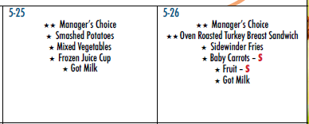
Empowering Managers
A district wide rollout of “Manager’s Choice” on the menu has provided another tool managers can use to clear up inventory and help to avoid waste.
Permitting management to take ownership of their inventory levels, being accountable for how items are utilized.
This was a shift in culture that was needed and has benefited the Division fiscally.
Notes:
TELL: Another very proven effective measure we took this past school year was a district wide rollout of “Manager’s Choice” on the menu. This provided another tool managers can use to clear up inventory and help to avoid waste. This Permitted management to take ownership of their inventory levels, being accountable for how items are utilized. This was a shift in culture that was needed and has benefited the Division in a great way.

Slide 35
“Managers Choice”
Managers can utilize this great tool to entice customers and clear inventory levels.
Have a successful “Managers Choice” by:
Exciting Customers | Utilize Inventory
Talk up the day beforehand and create a buzz Create favorable expectations Utilize PA announcements to announce a “Managers special” | Use broken cases of food to maximize the product usage Mix it up and serve multiple entrées to maximize usage
Notes:
TELL: Managers can utilize this great tool to entice customers and clear inventory levels at the same time. Here are a few tips to having a successful “Managers Choice.” Excite customers by talking up the exciting menu day beforehand and creating a buzz with your audience. Also create favorable expectations while utilizing the resources from the school like PA announcements. Make the most of your inventory by using broken cases of food and don’t hesitate to utilize multiple entrees for the day to maximize inventory usage.

Slide 36
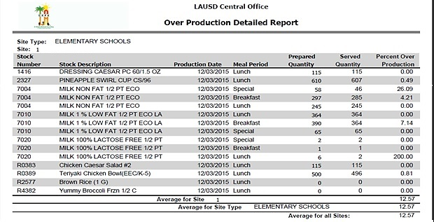
Over-Production Detailed Report (OPDR)
Generating the CMS “Over-Production Detailed Report” to measure the excess production of a menu item during a serving period is a valuable tool to use.
This report details the:
Stock Number
Stock Description
Production Date
Meal Period
Prepared Quantity
Served Quantity
Percent Over Production
Notes:
TELL: Generating the CMS “Over-Production Detailed Report” to measure the excess production of a menu item during a serving period is a valuable tool to use when it comes to waste management which will result in better forecasting. This report details the, Stock Number, Stock Description, Production Date, Meal Period, Prepared Quantity, Served Quantity, and Percent Over Production.

Slide 37
How To Generate The Over Production Detailed Report
To generate the “Over-Production Detailed Report” in CMS:
1. Report > Production > Over-Production Report > GO
2. Select date for review
3. Select “All Serving Period”
4. Select “Detailed” under Report Type
5. Click Preview
Notes:
TELL: To generate the “Over-Production Detailed Report” in CMS:
1. Report > Production > Over-Production Report > GO
2. Select date for review
3. Select “All Serving Period”
4. Select “Detailed” under Report Type
5. Click Preview

Slide 38
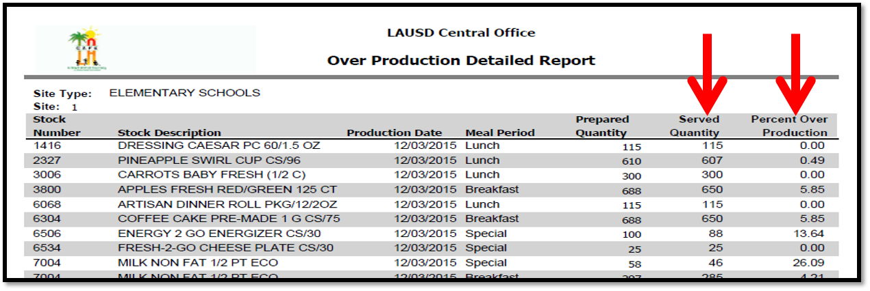
Using The Over Production Detailed Report
Review the “Percent Over Production” column to identify the food items that are greater than 5%
Then, add a 5% safety to the “Served Quantity” of that item for the next scheduled forecast
Note: The over-production target goal is below 5%.
Notes:
TELL: When using the over production detailed report, Review the “Percent Over Production” column to identify the food items that are greater than 5%. Then, add a 5% safety cushion to the “Served Quantity” of that item for the next scheduled forecast. Remember the over-production target goal is below 5%.

Slide 39
Reducing The Next Forecasts
To reduce high leftover amounts for the next forecast:
Identify items with “Percent Over Production” of 5%
Adjust orders to amounts of 5% above amount previously served
For Example:
Amount previously served | Additional 5% | Total amount of new forecast
400 | 20 | 420
Notes:
TELL: To reduce high leftover amounts for the next forecast Identify items with “Percent Over Production” of 5% and adjust orders to amounts of 5% above amount previously served. An example of this shows that you previously served a quantity of 400, 5% of 400 is 20, so for this particular item you want to add that 20 to the 400 to have a new forecasted amount of 420.

Slide 40
Best Practice On How To Control Food Cost
Ordering
Always physically check current inventory on hand
Avoid ordering unneeded items by revising and adjusting the quantities on the shopping list
Prepare orders based on customer preference
Set realistic par levels
Storing
Prevent waste by practicing FIFO (First In First Out)
Keep all storage areas organized
Store like items together in the same place
Notes:
TELL: Some best practices to control food cost are seen here. When ordering always physically check current inventory on hand, avoid ordering unneeded items by revising and adjusting the quantities on the shopping list, prepare orders based on customer preference, and set realistic par levels. When storing; prevent waste by practicing FIFO (First In First Out), keep all storage areas organized, and store like items together in the same place.

Slide 41
Best Practice On How To Control Food Cost Cont’d
Portion Control
Use the correct portion sizes per standardized recipes
Train staff on the correct usage of measuring equipment and portion control tools
Monitor staff periodically to ensure compliance
Record all FSD employee meals
Reduce Waste
Review the production history
BIC, Lunch, and Supper
Do not over produce food items: Over Production = Waste
Follow Offer vs. Serve guidelines
Notes:
TELL: Continue best practices with Portion Control by using the correct portion sizes per standardized recipes, train staff on the correct usage of measuring equipment and portion control tools, monitor staff periodically to ensure compliance and record all FSD employee meals. Reduce waste by reviewing the production history for BIC, Lunch, and Supper. Do not over produce food items, remember that over production leads to waste. And always be in compliance with offer vs. serve guidelines.

Slide 42
Using the Tools
Once becoming familiar with tools like the OPDR and Forecasting Tool, apply the knowledge gained by:
Reducing Waste
Keeping costs down
Maximizing product usage
Serving smart
Notes:
TELL: Use the tools so that you become familiar with all of the resources and reduce waste, keep costs down, maximize product usage, and serve smart.

Slide 43
Reduce Waste
The district has implemented strategies such as SIFL (Save it For Later) to reduce waste and encourage consumption all year. Continue this by:
Encouraging a team effort to hold everyone accountable
Track and analyze waste
Review inventory being received and note changes that can be made
Conduct inventory frequently
Be positive in your approach to staff and customers.
Notes:
TELL: The district has implemented strategies such as SIFL (Save it For Later) to reduce waste and encourage consumption all year. Continue this by being active and encouraging a team effort to hold everyone accountable. Track and analyze waste by reviewing inventory that is received and note changes that can be made. Conduct inventory frequently not just monthly and be positive in your approach to staff and customers to increase participation.

Slide 44
Increasing Participation Tips
Over the next few slides we will discuss strategies that can increase participation. Increased participation goes hand in hand with forecasting, ordering, and waste management.
Increasing participation will:
Grow the cafeteria operation
Make better use of food costs
Increase revenue
Utilize inventory
Let’s take a look at some ways to increase participation
Notes:
TELL: Over the next few slides we will discuss strategies that can increase participation. A result of increased participation will work excellent with forecasting, ordering, and waste management.
Increasing participation will grow the cafeteria operation, make better use of food costs, increase revenue, and utilize inventory.
Let’s take a look at some ways to increase participation

Slide 45
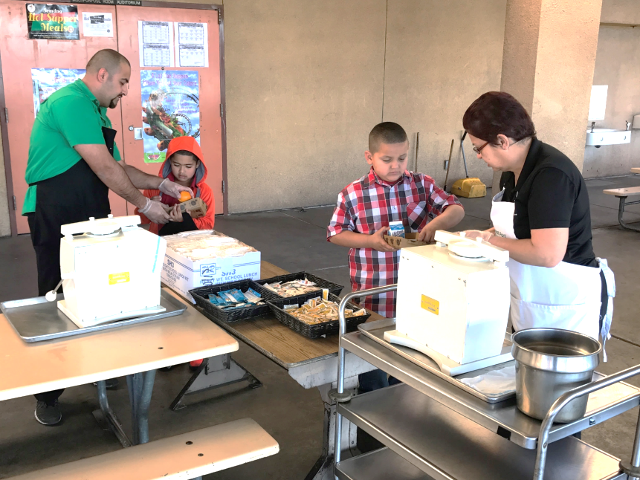
Convenience Increases Consumption
Implementing a fresh fruit cutting station can show immediate results:
Reducing the amount of fruit discarded
Increasing excitement
Students are excited to see fruit custom cut for their enjoyment
Stations can be conveniently located near utensils and condiments
Staff has an opportunity to further engage positively with student customers
Notes:
TELL: BY implementing a fresh fruit cutting station it can show immediate results. We've already seen it to reduce the amount of fruit discarded, increase excitement because students are excited to see fruit custom cut for their enjoyment. These stations can be conveniently located near utensils and condiments and it gives staff the opportunity to further engage positively with student customers creating a more personable experience.

Slide 46
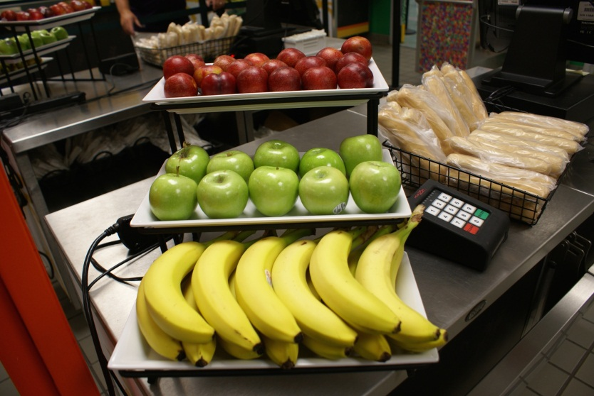
Move The Fruits and Vegetables
Offer fruits and vegetables at more than one location.
Similar to a supermarket, when choices are available at the POS it creates an impulse for students to select a healthy option to accompany their meal.
Notes:
TELL: Placement of fruits and vegetables is also important. Offer fruits and vegetables at more than one location. Similar to a supermarket, when choices are available at the POS it creates an impulse for students to select a healthy option to accompany their meal.

Slide 47
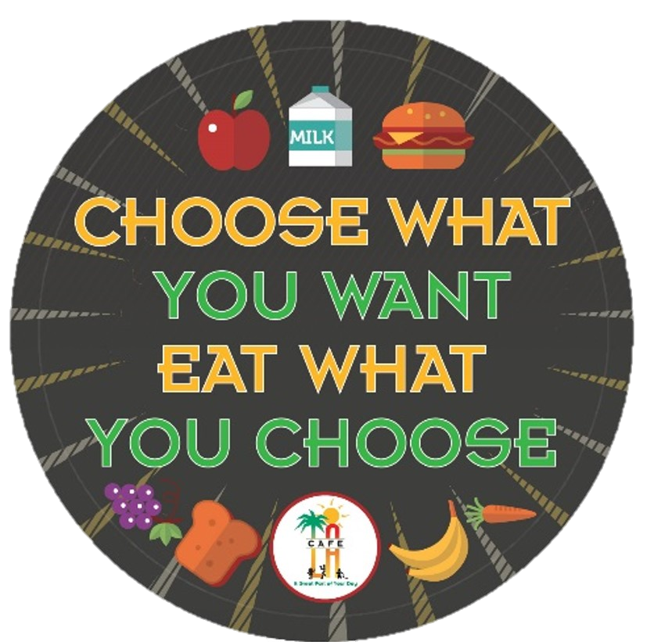
CHOOSE!
Encourage students to do just that and this can reduce waste one student at a time.
Notes:
TELL: LAUSD created the “Choose What You Want, Eat What You Choose” slogan that students can easily understand. This slogan goes beyond nutrition education by also encouraging a reduction of waste. At the start of the next school year, school sites will implement the “Choose” campaign.

Slide 48
Questions?
LAUSD Food Services Division
Nourishing Children to Achieve Excellence
Notes:
TELL: Any Question? Thank you for attending today’s training.

